Slide 1
BIOps: QuickSight Objects Migration and Version Control
Ying Wang (@wangzyn), Data Visualization Engineer.
AWS Professional Services – Data Analytics Practice
8-25-2020

Slide 2
About Me
Engineer, Consultant, Solution Architect in MSTR
AWS Professional Services – Data Analytics Practice
Helping Customers to unlock the power of Data with QuickSight

Slide 3
Agenda
DevOps → BIOps
QuickSight Dashboards Development Workflow
Migration across Accounts, Regions
Dashboard Version Control in One Account
QuickSight API Introduction
Sample Notebooks of Migration Scripts
Q&A

Slide 4
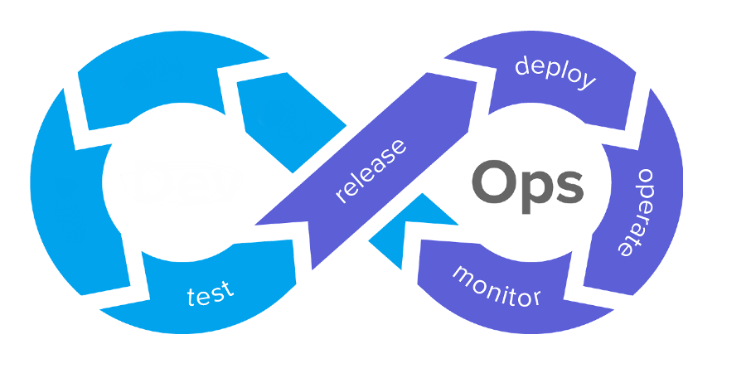
DevOps→BIOps
dataset
ux/ui
BI
dashboard

Slide 5





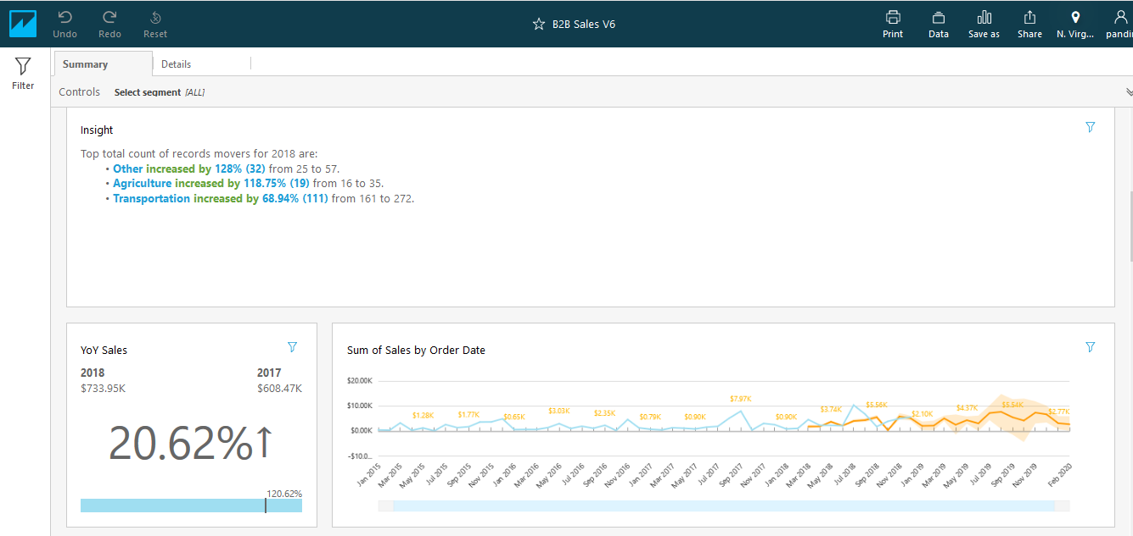





Create data set
Check ingestion status
User 1
Group 1
Create data source
Refresh or Set refresh schedule
User 2
Namespace 1
Create analysis (manual)
Scope down policy API
Share dashboard w/ user/group
Create template API
List and Describe dashboard API
Create dashboard
Apply theming

Slide 6
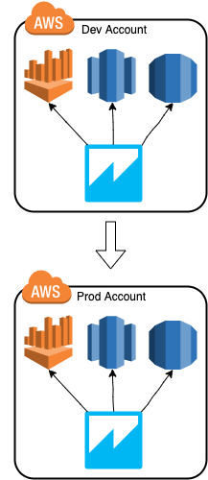
Migration Across Accounts Automatically
Create data set API
Check ingestion status API
API: List data sources in dev
Create data source in prod
Refresh or Set refresh schedule API
Create template API
Share dashboard w/ user/group API
Apply theming APIs
Copy template
Create dashboard API

Slide 7

Dashboard Version Control in One Account
Create analysis
Version: 1
Create template API
Version: 1
Update template API
Version: 2
Pass
QA test
QA test
Fail
Update analysis (manual)
Version: 2
Publish dashboard
Version: 2
Publish dashboard
Version: 1
Rollback to version 1 analysis
Version: 1

Slide 8
QuickSight API Introduction
https://docs.aws.amazon.com/quicksight/latest/APIReference/Welcome.html
https://boto3.amazonaws.com/v1/documentation/api/latest/reference/services/quicksight.html
http://sko-workshop.learnquicksight.online/en/exercises/development-environment-setup/using-quicksight-apis.html

Slide 9
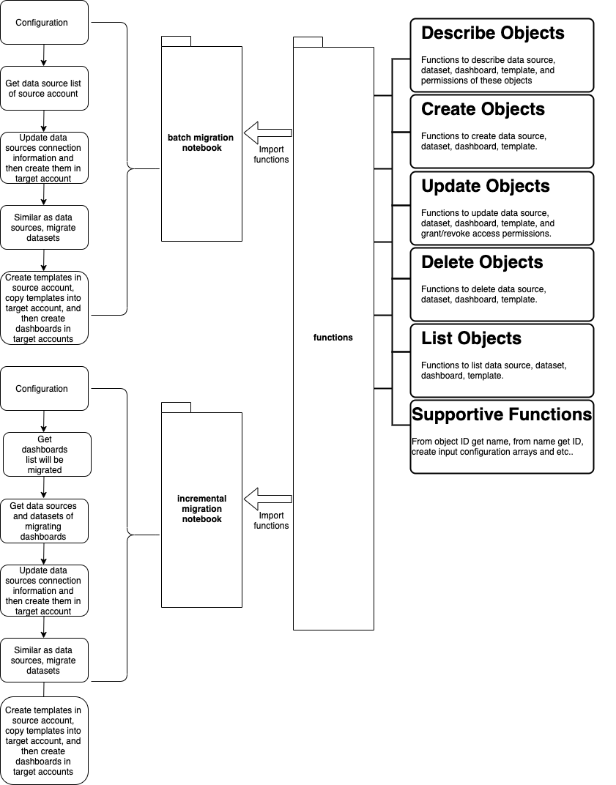
Sample Migration Scripts
Link

Slide 10
Demo

Slide 11
Q&A

Slide 12
How To Engage Us?
QuickSight Packed Offering We Provided:
AWS QuickSight Architecture Design Workshop
AWS Embedded BI Workshop with Amazon Quicksight
Contact Us:
aws-proserve-data@

Slide 13
Thank You!

